Slide 1
DEADLOCKS
BSCS-IV

Slide 2
DEADLOCK
A deadlock in OS is a situation in which more than one process is blocked because it is holding a resource and also requires some resource that is acquired by some other process. Therefore, none of the processes gets executed.
A deadlock occurs when a set of processes is stalled because each process is holding a resource and waiting for another process to acquire another resource. In the diagram, for example, Process 1 is holding Resource 1 while Process 2 acquires Resource 2, and Process 2 is waiting for Resource 1.

Slide 3
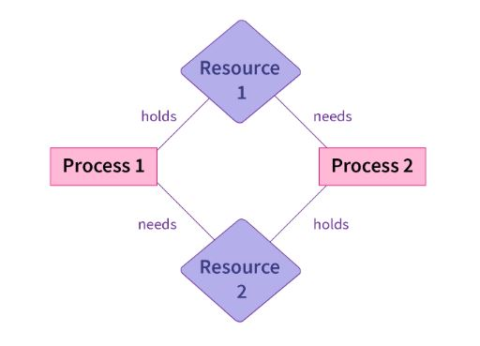
DEADLOCK

Slide 4
SYSTEM MODEL
A system model or structure consists of a fixed number of resources to be circulated among some opposing processes.
The resources are then partitioned into numerous types, each consisting of some specific quantity of identical instances.
Memory space, CPU cycles, directories and files, I/O devices like keyboards, printers and CD-DVD drives are prime examples of resource types.
When a system has 2 CPUs, then the resource type CPU got two instances.

Slide 5
SYSTEM MODEL
Under the standard mode of operation, any process may use a resource in only the below-mentioned sequence:
Request: When the request can't be approved immediately (where the case may be when another process is utilizing the resource), then the requesting job must remain waited until it can obtain the resource.
Use: The process can run on the resource (like when the resource is a printer, its job/process is to print on the printer).
Release: The process releases the resource (like, terminating or exiting any specific process).

Slide 6
NECESSARY CONDITIOLNS FOR DEADLOCK:
The four necessary conditions for a deadlock to arise are as follows.
Mutual Exclusion: Only one process can use a resource at any given time i.e. the resources are non-sharable.
Hold and wait: A process is holding at least one resource at a time and is waiting to acquire other resources held by some other process.
No Preemption: The resource can be released by a process voluntarily i.e. after execution of the process.

Slide 7
NECESSARY CONDITIOLNS FOR DEADLOCK:
Circular Wait: A set of processes are waiting for each other in a circular fashion. For example, lets say there are a set of processes {P0​, P1​, P2​, P3​} such that:
P0​ depends on P1​,
P1​ depends on P2​,
P2​ depends on P3​ and
P3​ depends on P0​.
This creates a circular relation between all these processes and they have to wait forever to be executed.

Slide 8
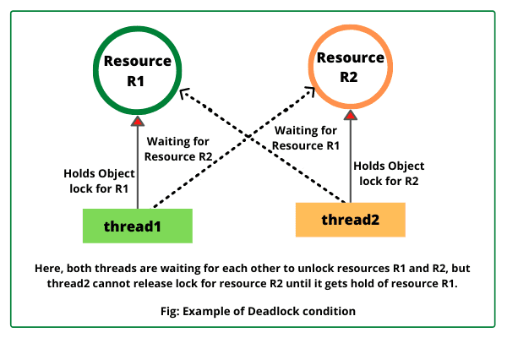
DEADLOCK IN MULTITHREADED APPLICATION

Slide 9
Methods of Handling Deadlocks in Operating System
Deadlock Prevention
Deadlock Avoidance
Deadlock Detection and Recovery
The first two methods are used to ensure the system never enters a deadlock.

Slide 10
Methods of Handling Deadlocks in Operating System
Normally you can deal with the deadlock issues and situations in one of the three ways mentioned below:
1. You can employ a protocol for preventing or avoiding deadlocks, and ensure that the system will never go into a deadlock state.
2. You can let the system to enter any deadlock condition, detect it, and then recover.
3. You can overlook the issue altogether and assume that deadlocks never occur within the system.
But is recommended to deal with deadlock, from the 1st option

Slide 11
1. Deadlock Prevention
Deadlocks can be avoided by avoiding at least one of the four necessary conditions: as follows.
Condition-1 : Mutual Exclusion :
Read-only files, for example, do not cause deadlocks.
Unfortunately, some resources, such as printers and tape drives, require a single process to have exclusive access to them.

Slide 12
1. Deadlock Prevention
Condition-2 :
Hold and Wait :
To avoid this condition, processes must be prevented from holding one or more resources while also waiting for one or more others. There are a few possibilities here:
Make it a requirement that all processes request all resources at the same time. This can be a waste of system resources if a process requires one resource early in its execution but does not require another until much later.
Processes that hold resources must release them prior to requesting new ones, and then re-acquire the released resources alongside the new ones in a single new request. This can be a problem if a process uses a resource to partially complete an operation and then fails to re-allocate it after it is released.
If a process necessitates the use of one or more popular resources, either of the methods described above can result in starvation.

Slide 13
1. Deadlock Prevention
Condition-3 : No Preemption :
When possible, preemption of process resource allocations can help to avoid deadlocks.
One approach is that if a process is forced to wait when requesting a new resource, all other resources previously held by this process are implicitly released (preempted), forcing this process to re-acquire the old resources alongside the new resources in a single request, as discussed previously.
Another approach is that when a resource is requested, and it is not available, the system looks to see what other processes are currently using those resources and are themselves blocked while waiting for another resource. If such a process is discovered, some of their resources may be preempted and added to the list of resources that the process is looking for.
Either of these approaches may be appropriate for resources whose states can be easily saved and restored, such as registers and memory, but they are generally inapplicable to other devices, such as printers and tape drives.

Slide 14
1. Deadlock Prevention
Condition-4 : Circular Wait :
To avoid circular waits, number all resources and insist that processes request resources is strictly increasing ( or decreasing) order.
To put it another way, before requesting resource Rj, a process must first release all Ri such that I >= j.
The relative ordering of the various resources is a significant challenge in this scheme.

Slide 15
2. DEADLOCK AVOIDANCE
By using the strategy of “Avoidance”, we have to make an assumption. We need to ensure that all information about resources that the process will need is known to us before the execution of the process.
In prevention and avoidance, we get the correctness of data but performance decreases.

Slide 16
2. DEADLOCK AVOIDANCE
Operating System avoids Deadlock by knowing the maximum resources requirements of the processes initially, and also Operating System knows the free resources available at that time.
Operating System tries to allocate the resources according to the process requirements and checks if the allocation can lead to a safe state or an unsafe state.
If the resource allocation leads to an unsafe state, then Operating System does not proceed further with the allocation sequence.

Slide 17
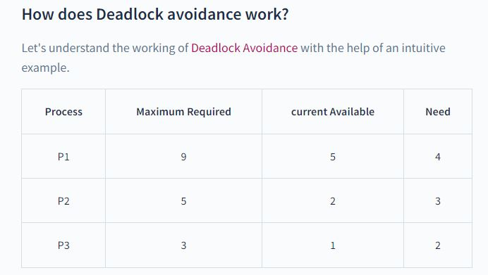
2. DEADLOCK AVOIDANCE

Slide 18
2. DEADLOCK AVOIDANCE
SAFE STATE
Let's consider three processes P1, P2, P3. Some more information on which the processes tells the Operating System are :
P1 process needs a maximum of 9 resources (Resources can be any software or hardware Resource like tape drive or printer etc..) to complete its execution. P1 is currently allocated with 5 Resources and needs 4 more to complete its execution.
P2 process needs a maximum of 5 resources and is currently allocated with 2 resources. So it needs 3 more resources to complete its execution.
P3 process needs a maximum of 3 resources and is currently allocated with 1 resource. So it needs 2 more resources to complete its execution.
Operating System knows that only 2 resources out of the total available resources are currently free.

Slide 19
2. DEADLOCK AVOIDANCE
SAFE STATE
But only 2 resources are free now. Can P1, P2, and P3 satisfy their requirements? Let's try to find out.
As only 2 resources are free for now, then only P3 can satisfy its need for 2 resources. If P3 takes 2 resources and completes its execution, then P3 can release its 3 (1+2) resources.
Now the three free resources which P3 released can satisfy the need of P2. Now, P2 after taking the three free resources, can complete its execution and then release 5 (2+3) resources. Now five resources are free. P1 can now take 4 out of the 5 free resources and complete its execution. So, with 2 free resources available initially, all the processes were able to complete their execution leading to Safe State. The order of execution of the processes was <P3, P2, P1>.

Slide 20
2. DEADLOCK AVOIDANCE
UNSAFE STATE
What if initially there was only 1 free resource available? None of the processes would be able to complete its execution. Thus leading to an unsafe state.
So, If Operating System is able to allocate or satisfy the maximum resource requirements of all the processes in any order then the system is said to be in Safe State.
So safe state does not lead to Deadlock.
Unsafe State - If Operating System is not able to prevent Processes from requesting resources which can also lead to Deadlock, then the System is said to be in an Unsafe State.
Unsafe State does not necessarily cause deadlock it may or may not causes deadlock.

Slide 21
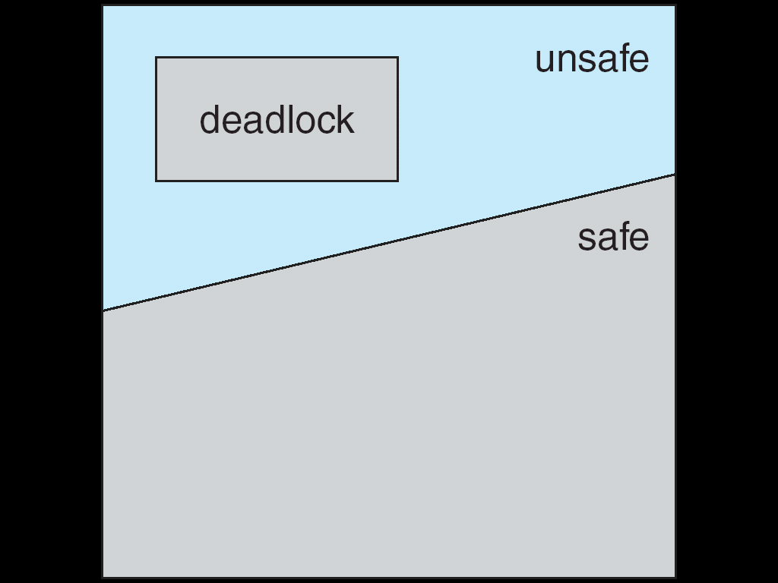
SAFE STATE, UNSAFE STATE and DEADLOCK

Slide 22
DEADLOCK AVOIDANCE ALGORITHMS
RESOURCE ALOCATION GRAPH
- Single Instance of a Resource Type
BANKER’S ALGORITHM
- Multiple Instances of a Resource Type

Slide 23
RESOURCE ALLOCATION GRAPH
A set of vertices V and a set of edges E.
V is partitioned into two types:
P = {P₁, P₂, …, P_{n}}, the set consisting of all the processes in the system
R = {R₁, R₂, …, R_{m}}, the set consisting of all resource types in the system
request edge – directed edge P_{i} → R_{j}
assignment edge – directed edge R_{j} → P_{i}

Slide 24
RESOURCE ALLOCATION GRAPH
Process
Resource Type with 4 instances
P_{i} requests instance of R_{j}
P_{i} is holding an instance of R_{j}
P_{i}
P_{i}

Slide 25
Resource-Allocation Graph Scheme
Claim edge P_{i} → R_{j} indicated that process P_{j} may request resource R_{j}; represented by a dashed line
Claim edge converts to request edge when a process requests a resource
Request edge converted to an assignment edge when the resource is allocated to the process
When a resource is released by a process, assignment edge reconverts to a claim edge
Resources must be claimed a priori in the system.

Slide 26
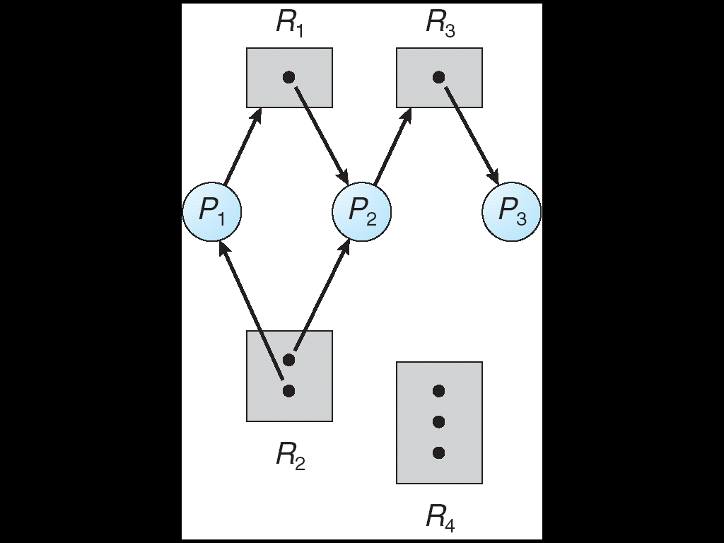
RAG - EXAMPLE

Slide 27
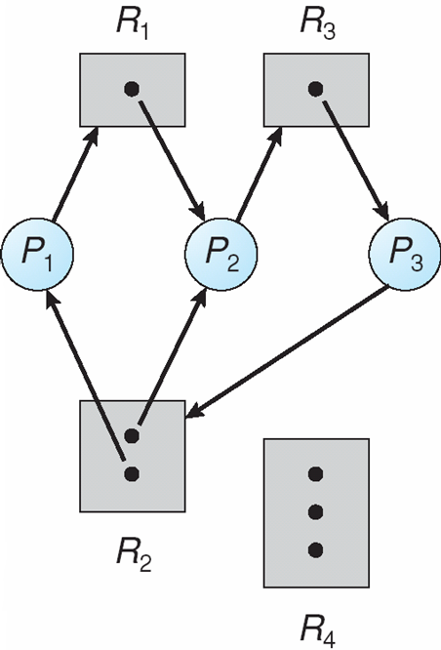
RAG – With a Deadlock

Slide 28
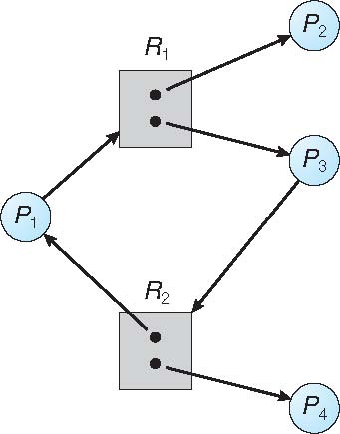
RAG – With a Cycle but Not a Deadlock

Slide 29
RESOURCE ALLOCATION GRAPH
Suppose that process P_{i} requests a resource R _{j}
The request can be granted only if converting the request edge to an assignment edge does not result in the formation of a cycle in the resource allocation graph

